Slide 1
Git-ting It Together: Learn to Use Git and GitHub for Your Projects
Eli Holmes and Em Markowitz

Slide 2
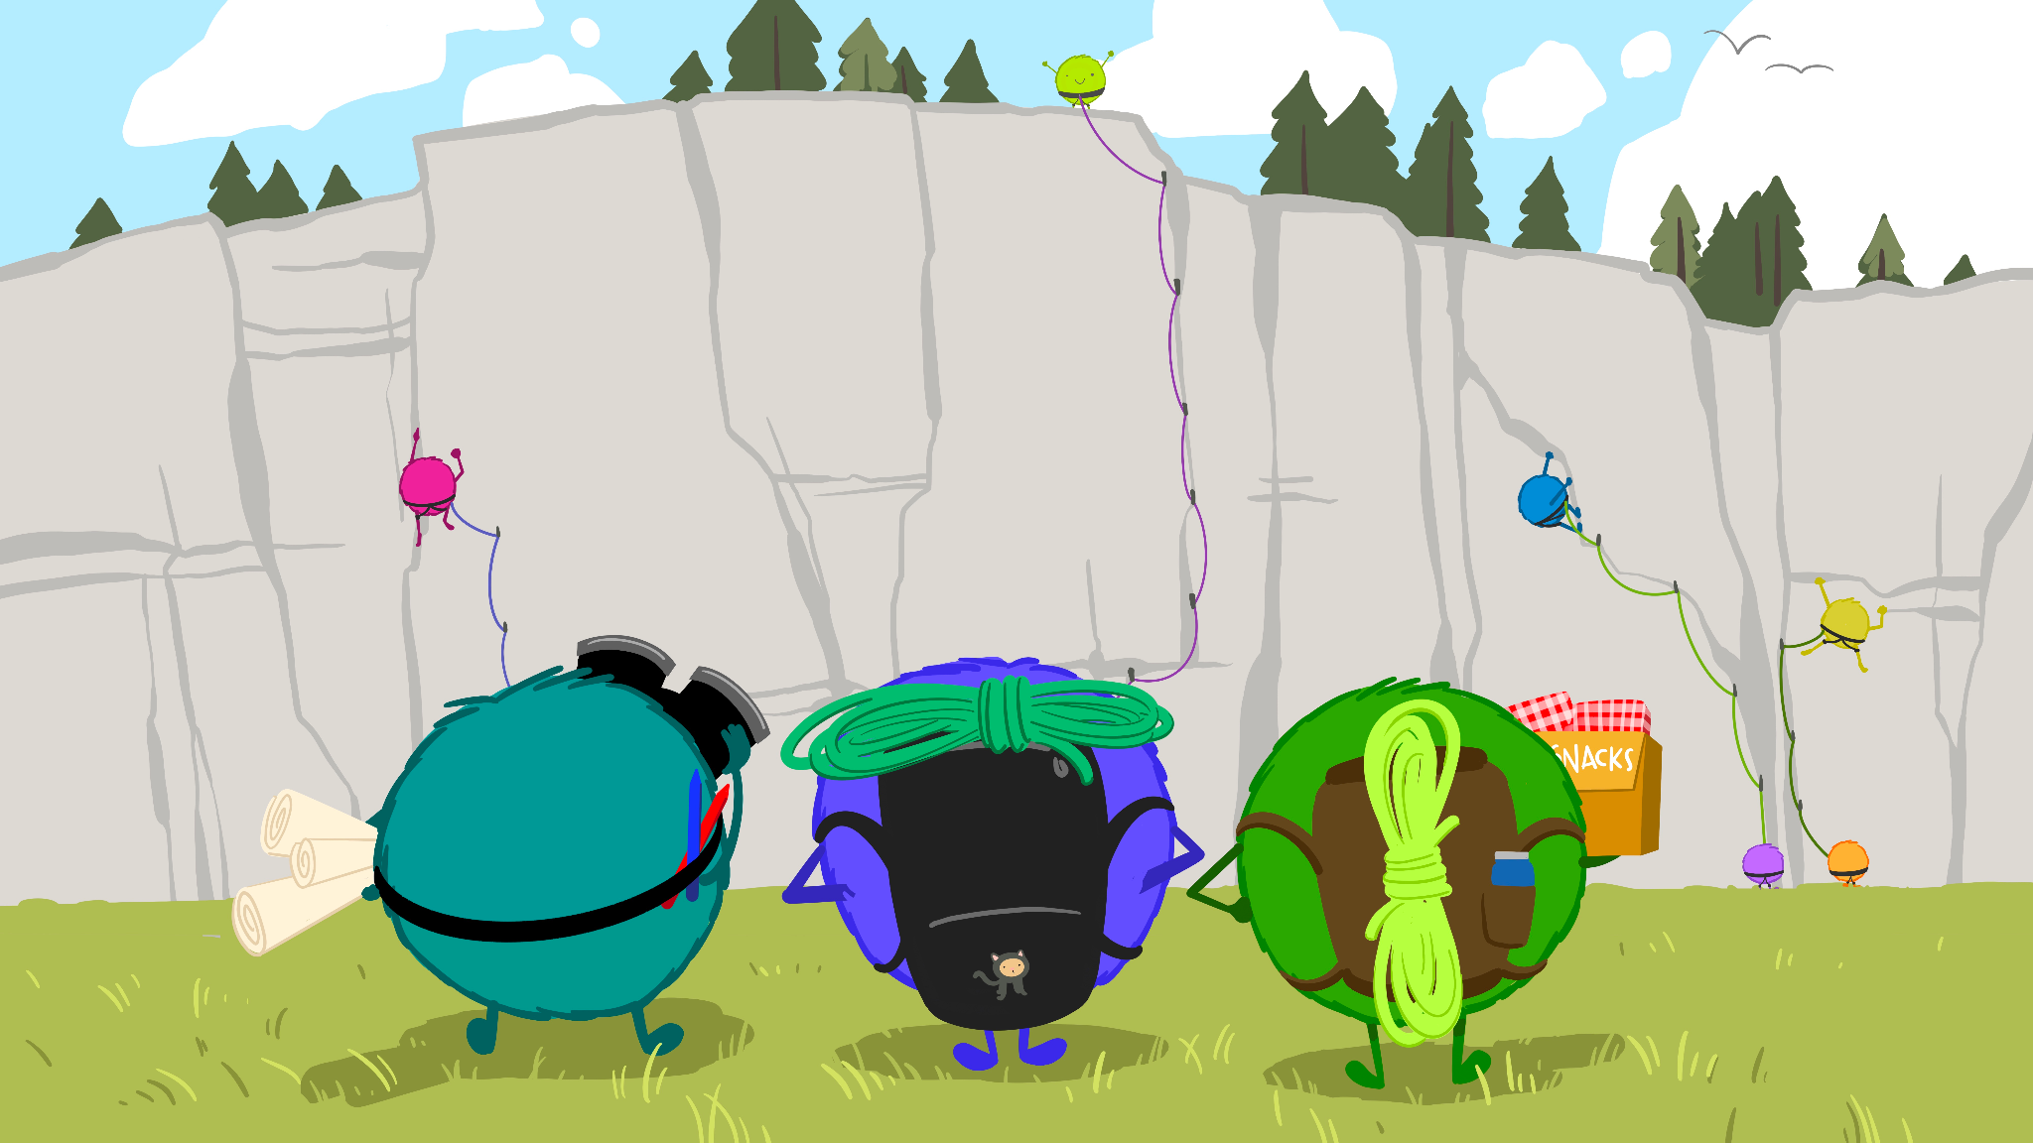
Using GitHub to Help a Team Tackle a Project Together
Artwork by @allison_horst

Slide 3
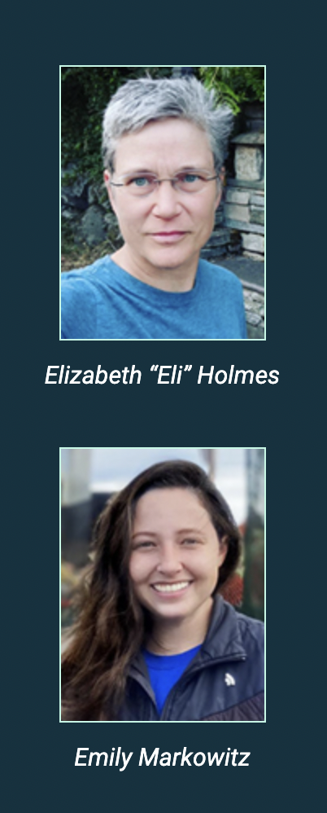
Scientists at NOAA Fisheries and mentors in the NOAA Fisheries Openscapes program. We help scientists adopt Open Science workflows
https://nmfs-openscapes.github.io/
https://github.com/EmilyMarkowitz-NOAA
https://github.com/eeholmes

Slide 4
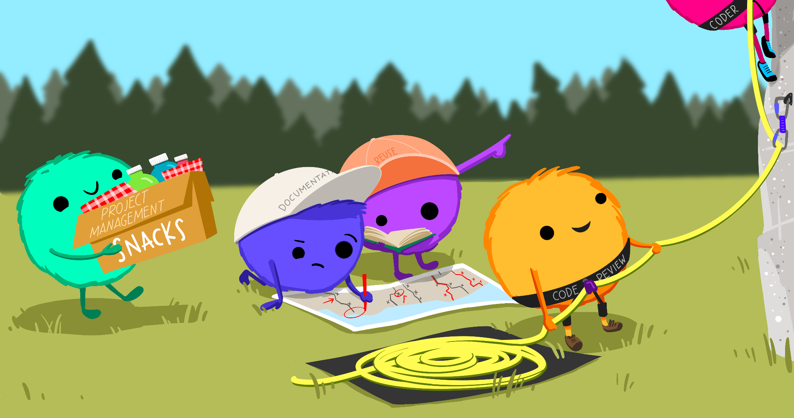
GitHub Project Boards
Kanban task board
Editing markdown files
Branches
Pull Requests
Artwork by @allison_horst

Slide 5
Schedule
8:15-10:45am
15-30 minute lectures and demos followed by 20-30 minute teamwork time
10:45-11am Break with snacks provided
11-12pm Lectures and team work time

Slide 6
Learning warm up! A game!

Slide 7
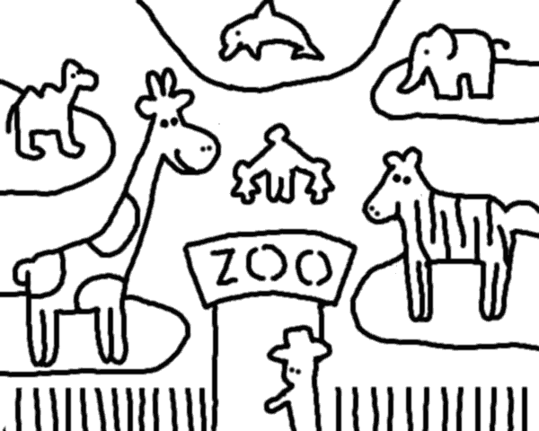
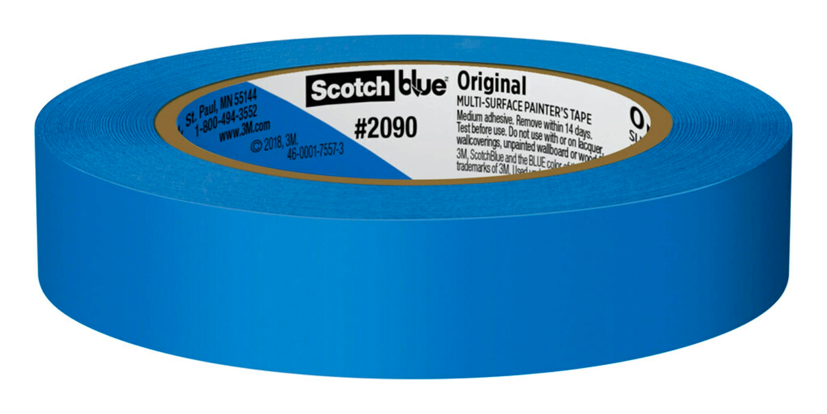
Team Activity: Draw a zoo or zoo exhibit
Use only post-it notes, blue tape, and sharpies for zoo elements

Slide 8
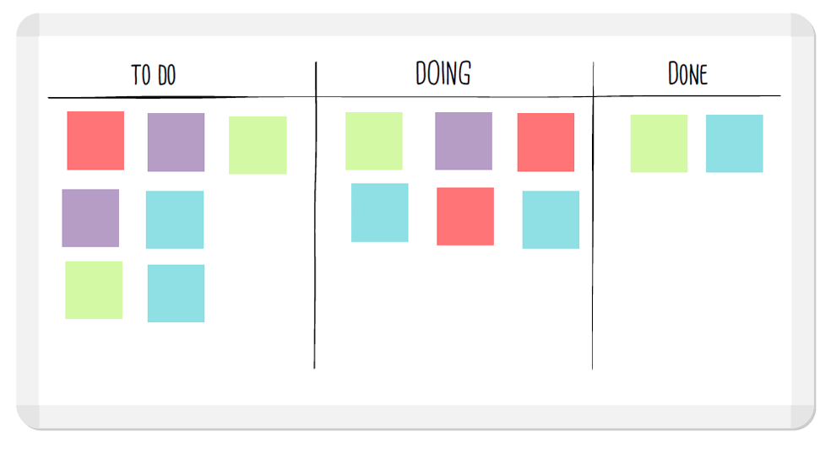
Rules
You can talk to each other
Only do tasks in the “to do” column
Only do tasks written by someone else
Everyone writes tasks
One task at a time
Move your task through the board

Slide 10
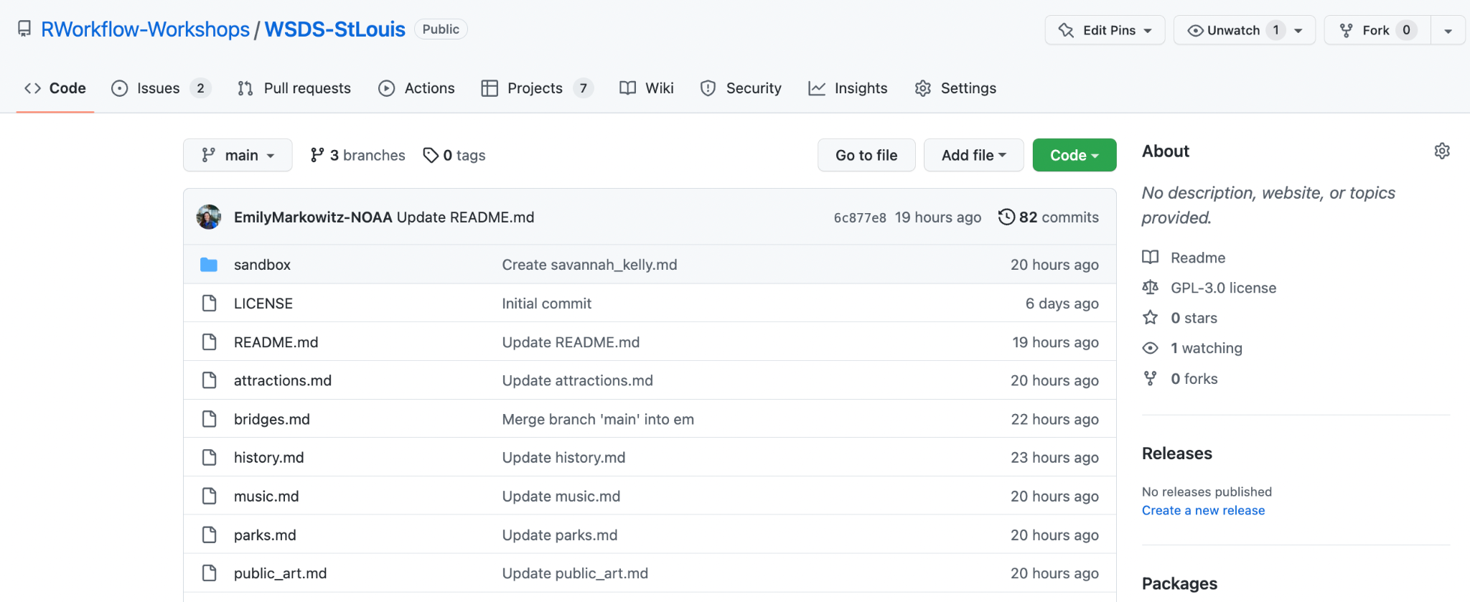
Intro to GitHub in the browser
https://github.com/RWorkflow-Workshops/WSDS-StLouis

Slide 11
Intro to GitHub in the browser
https://github.com/RWorkflow-Workshops/WSDS-StLouis

Slide 12
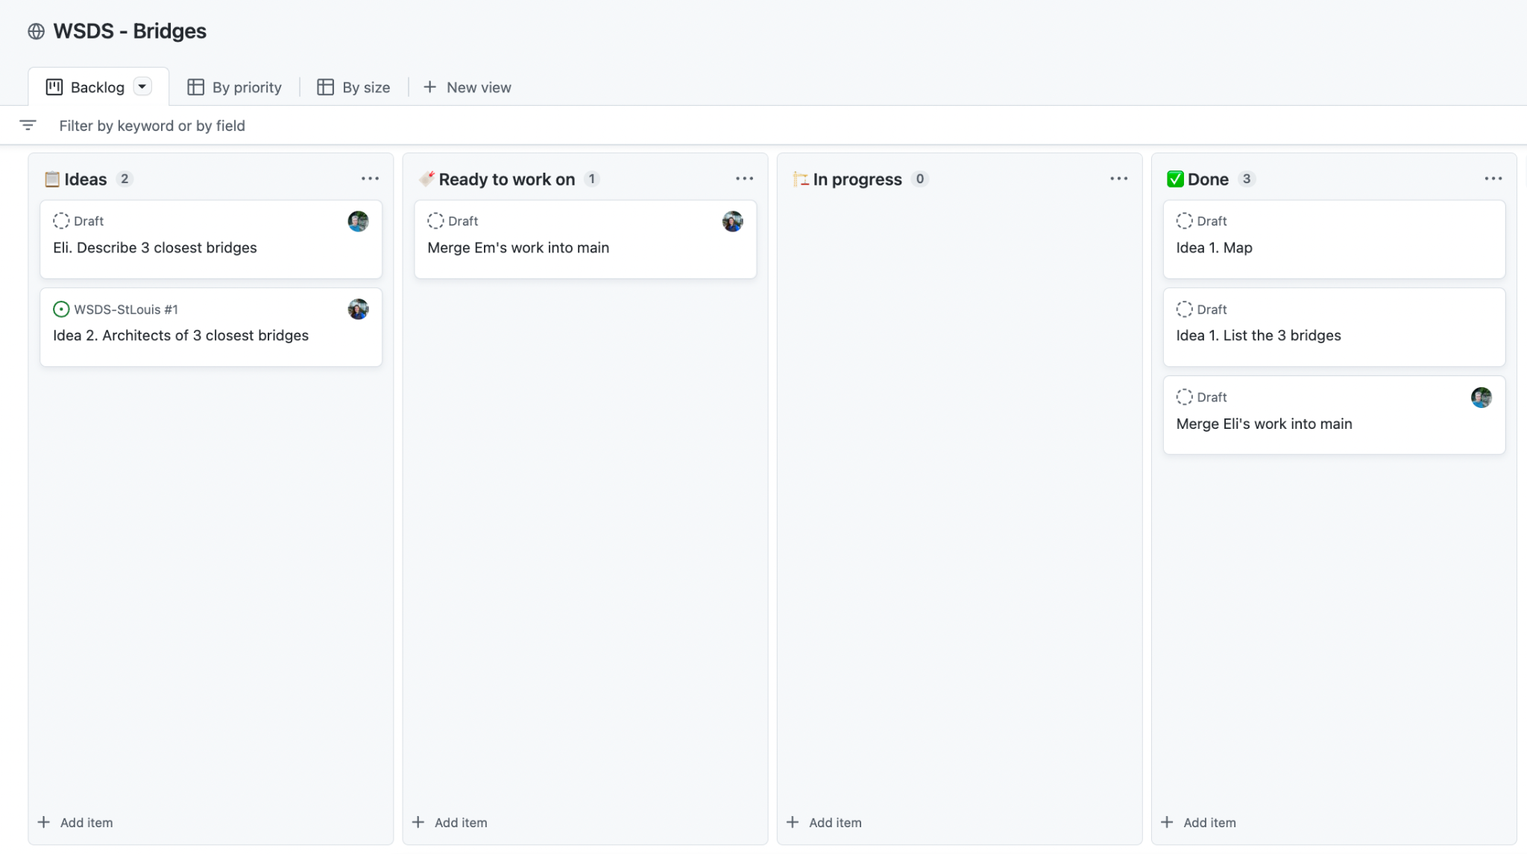
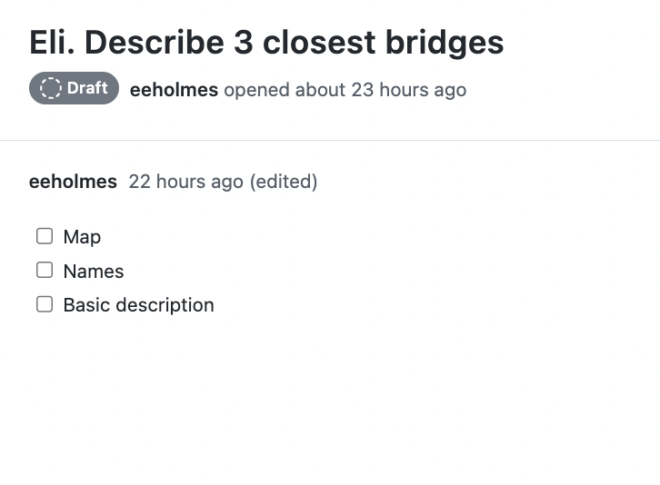
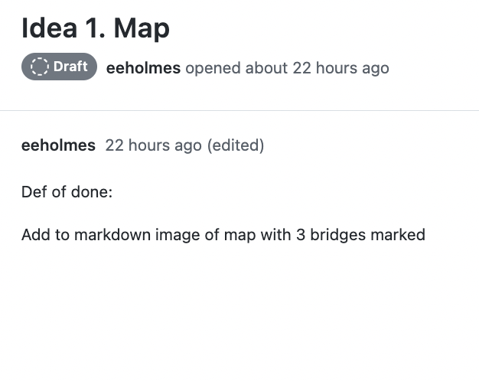
Intro to GitHub Project Boards
https://github.com/orgs/RWorkflow-Workshops/projects/6/views/1
IDEA CARD
TASK CARD

Slide 13
Eli and Em demo
Open their team project board
Add some notes/ideas to the idea column
Make 2-3 task cards in the task column
Task cards need ‘Definition of done’

Slide 14
Teams
Table 1: Music
Table 2: Public Art
Table 3: History
Table 4: Sports
Table 5: Parks
Table 6: Restaurants

Slide 15
Team work 30 min: Project boards
Add some idea cards (3-4) to your GitHub Project Board
Idea card is free form; helps you focus your tasks
https://youtu.be/8D72GBVBVe4
Add some (2-3) task cards for each idea
Task card must have a “definition of done”
https://youtu.be/frJoBaQqWmI
Tips
Don’t try to micromanage with “Definition of Done”
Let whoever grabs a task card, decide how to get to “done”

Slide 17
Editing files in the browser
https://github.com/RWorkflow-Workshops/WSDS-StLouis

Slide 18
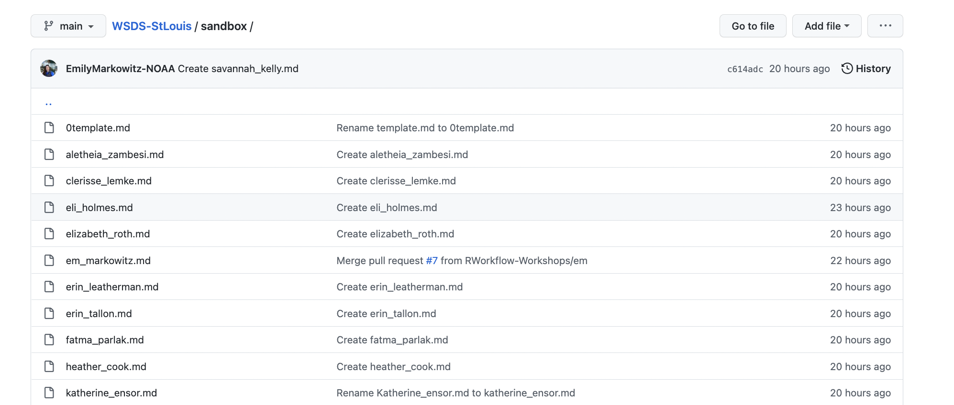
Opening files in the browser
https://github.com/RWorkflow-Workshops/WSDS-StLouis/tree/main/sandbox
Double click the file with your name to open

Slide 19
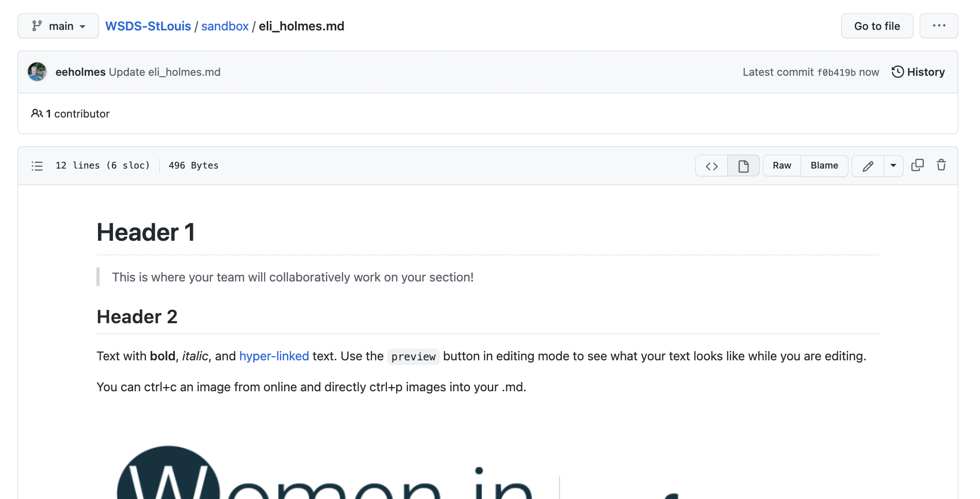
Edit a file

Slide 20
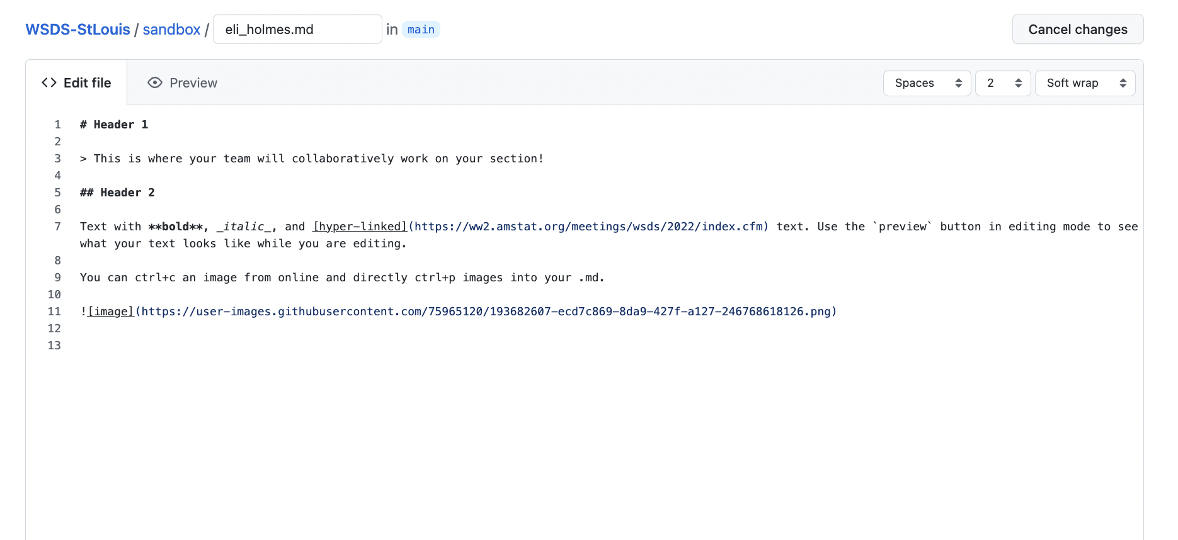
Edit a file: you can preview

Slide 21
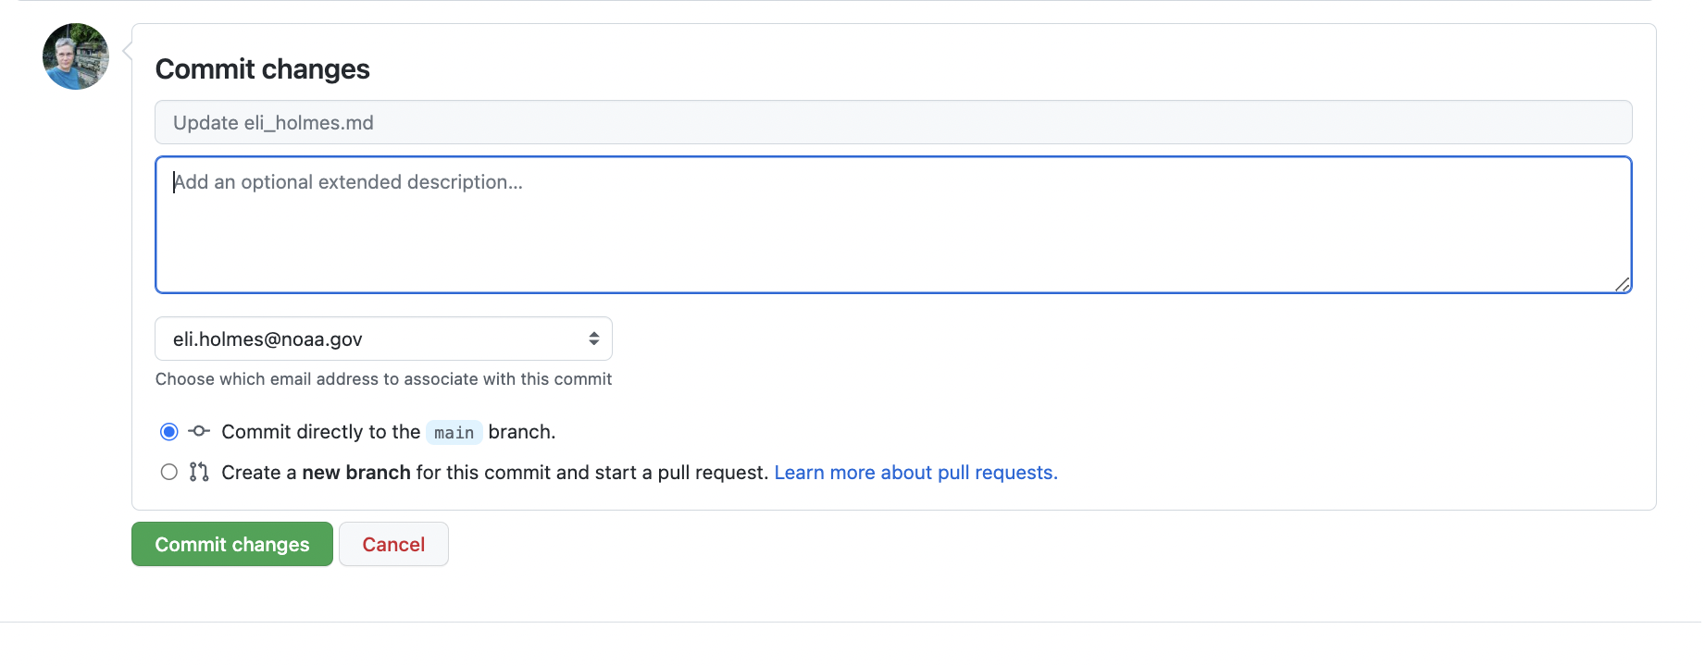
Commit your changes
Describe the change. Brief is fine

Slide 22
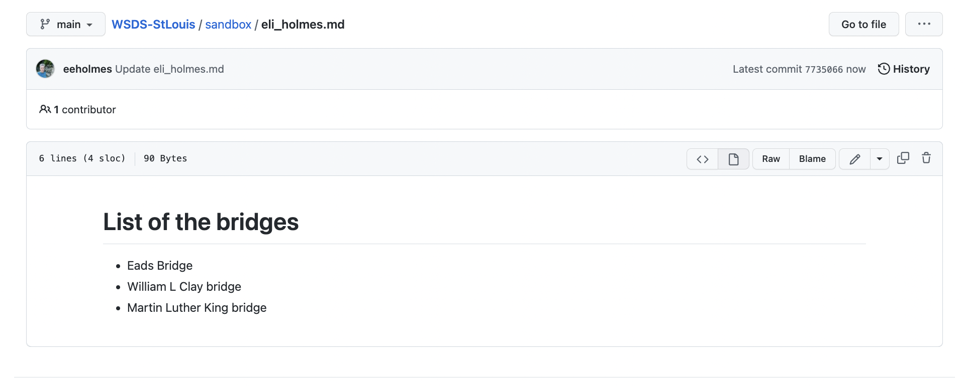
Click on history to see all the changes

Slide 23
Click on history to see all the changes
Click here to see the change
Click here to browse the files at that point in time

Slide 24
Em demos
Navigate to the sandbox directory
Open her markdown file
Make some changes
Header
Text with a link
Add an image

Slide 25
Individual work 20 min: Edit your file in the sandbox
Try
Adding a header
Adding a list
Adding an image
Make multiple commits
Click the history and look at the history
https://youtu.be/Ly4hdNSBKkA
https://www.markdownguide.org/cheat-sheet/
Images
You can right-click, copy image, and then paste
On a Mac, Cmd-Shift-4 gets you a snip tool for copying screen snips

Slide 27
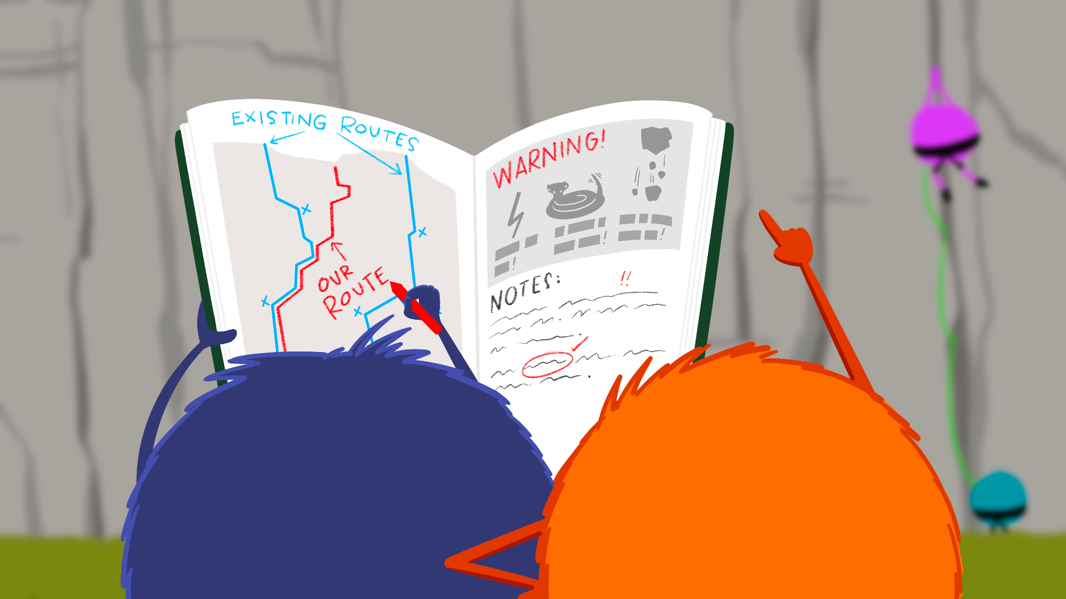
Let’s Start Team Work!
Artwork by @allison_horst

Slide 28
Goal is for the team to edit the one team markdown file
https://github.com/RWorkflow-Workshops/WSDS-StLouis

Slide 29
Eli and Em demo bad things happening if we both edit our team file

Slide 30
What is a branch?
https://github.com/RWorkflow-Workshops/WSDS-StLouis

Slide 31
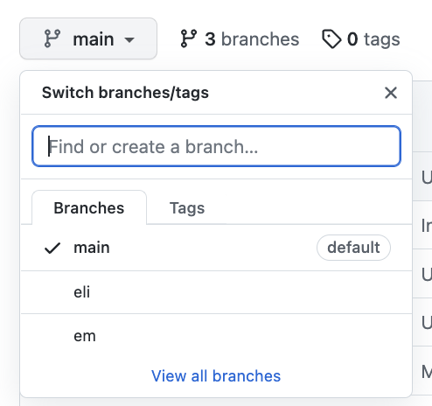
Create a branch in the browser
https://github.com/RWorkflow-Workshops/WSDS-StLouis
Click on “main” to get to branch controls
Click on an existing branch to see the status of the repo on that branch
Click here to see all the branches and do things (like delete).

Slide 32
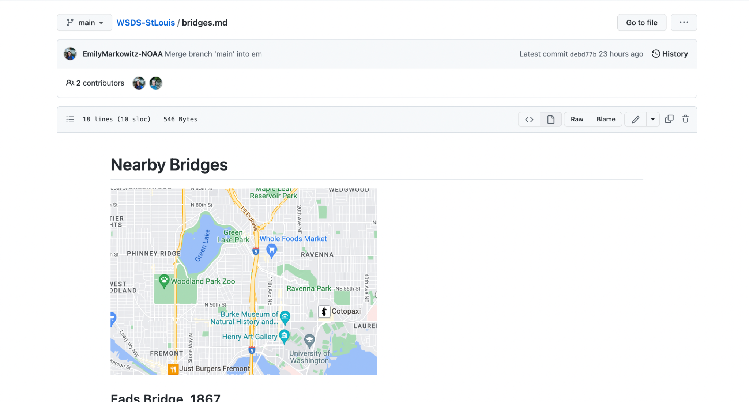
ALWAYS be aware of what branch you are on

Slide 33
Em demos
Make a branch FROM MAIN
Open the team markdown file
Double-check that you are on your branch
Edit the file and commit changes

Slide 34
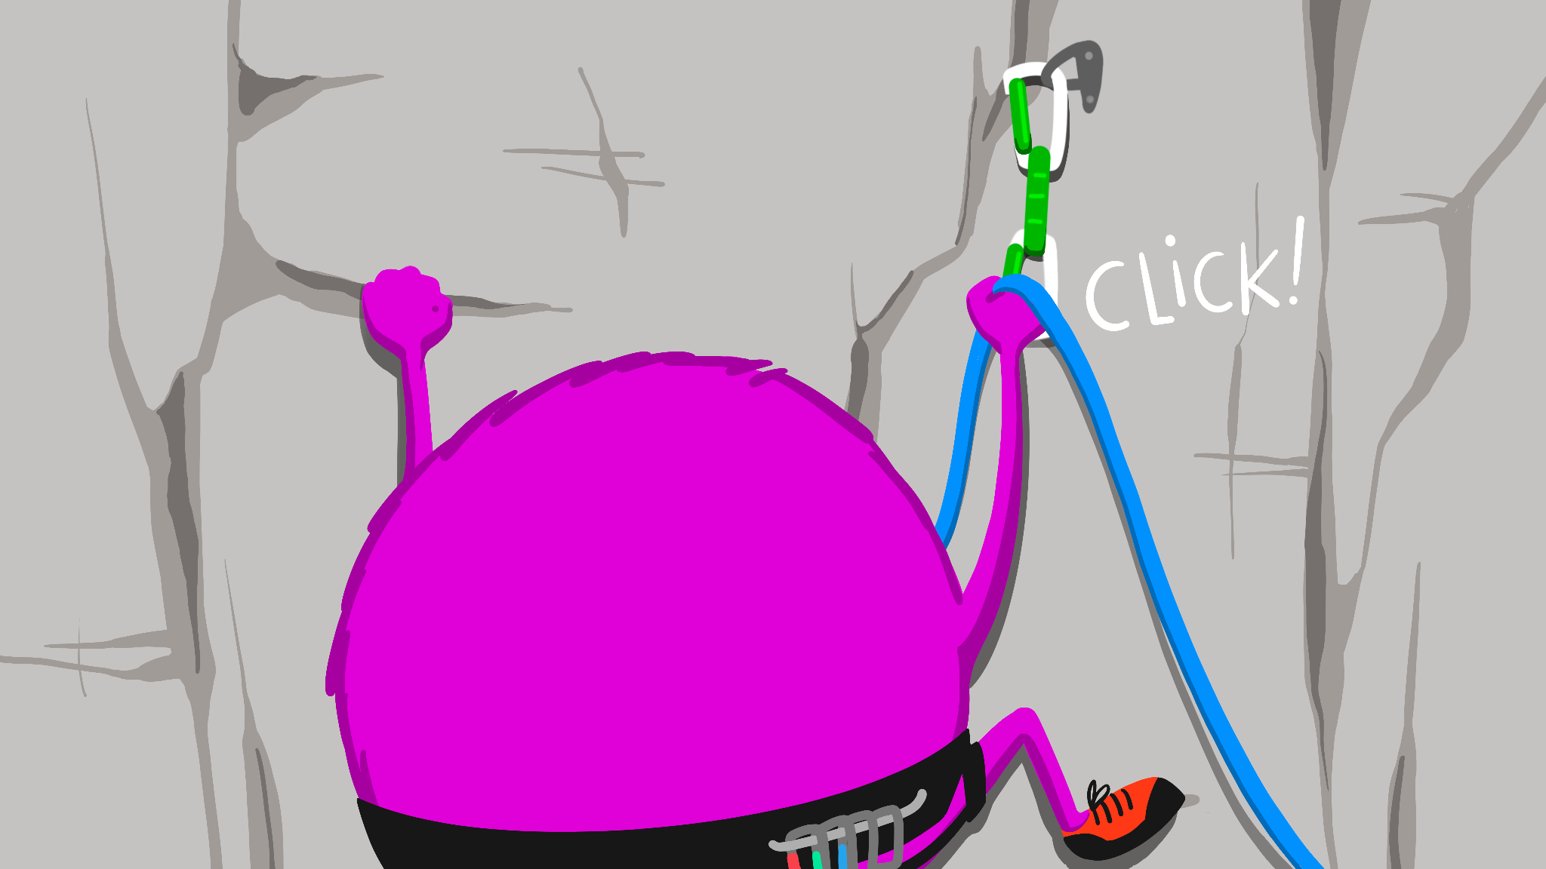
Team work 30 min: Work on tasks on your project board
Steps
Make a branch FROM MAIN
Switch to that branch
Open your team’s md file
Work on 2-3 tasks from your team task board
Double-check that you are in your own branch
https://youtu.be/Wt59IDTnpHU
Artwork by @allison_horst

Slide 36
Pull requests: merging your changes back into main
Artwork by @allison_horst

Slide 37
Pull requests: merging your changes back into main
Not here. We’ll look at this later.
Although “Pull requests” looks like the obvious place, lets go to the “View all branches” page

Slide 38
From ‘view all branches`
Click here to make a pull request
This shows that I am ahead of main

Slide 39
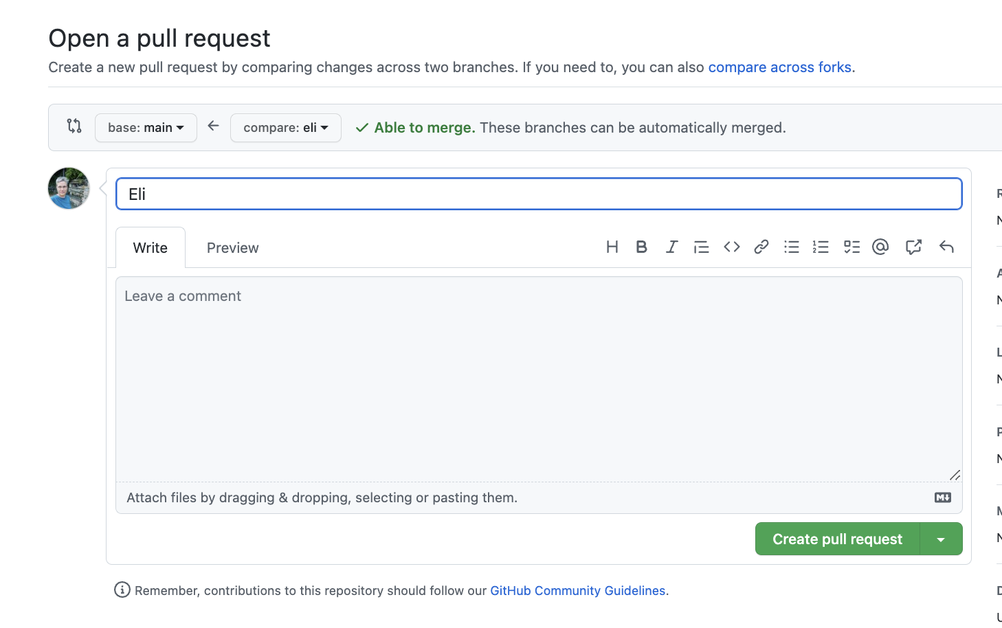
Make the pull request
It’s OK if this says merge conflict.
STOP. LOOK HERE!
All good? Click here to make the pull request

Slide 40
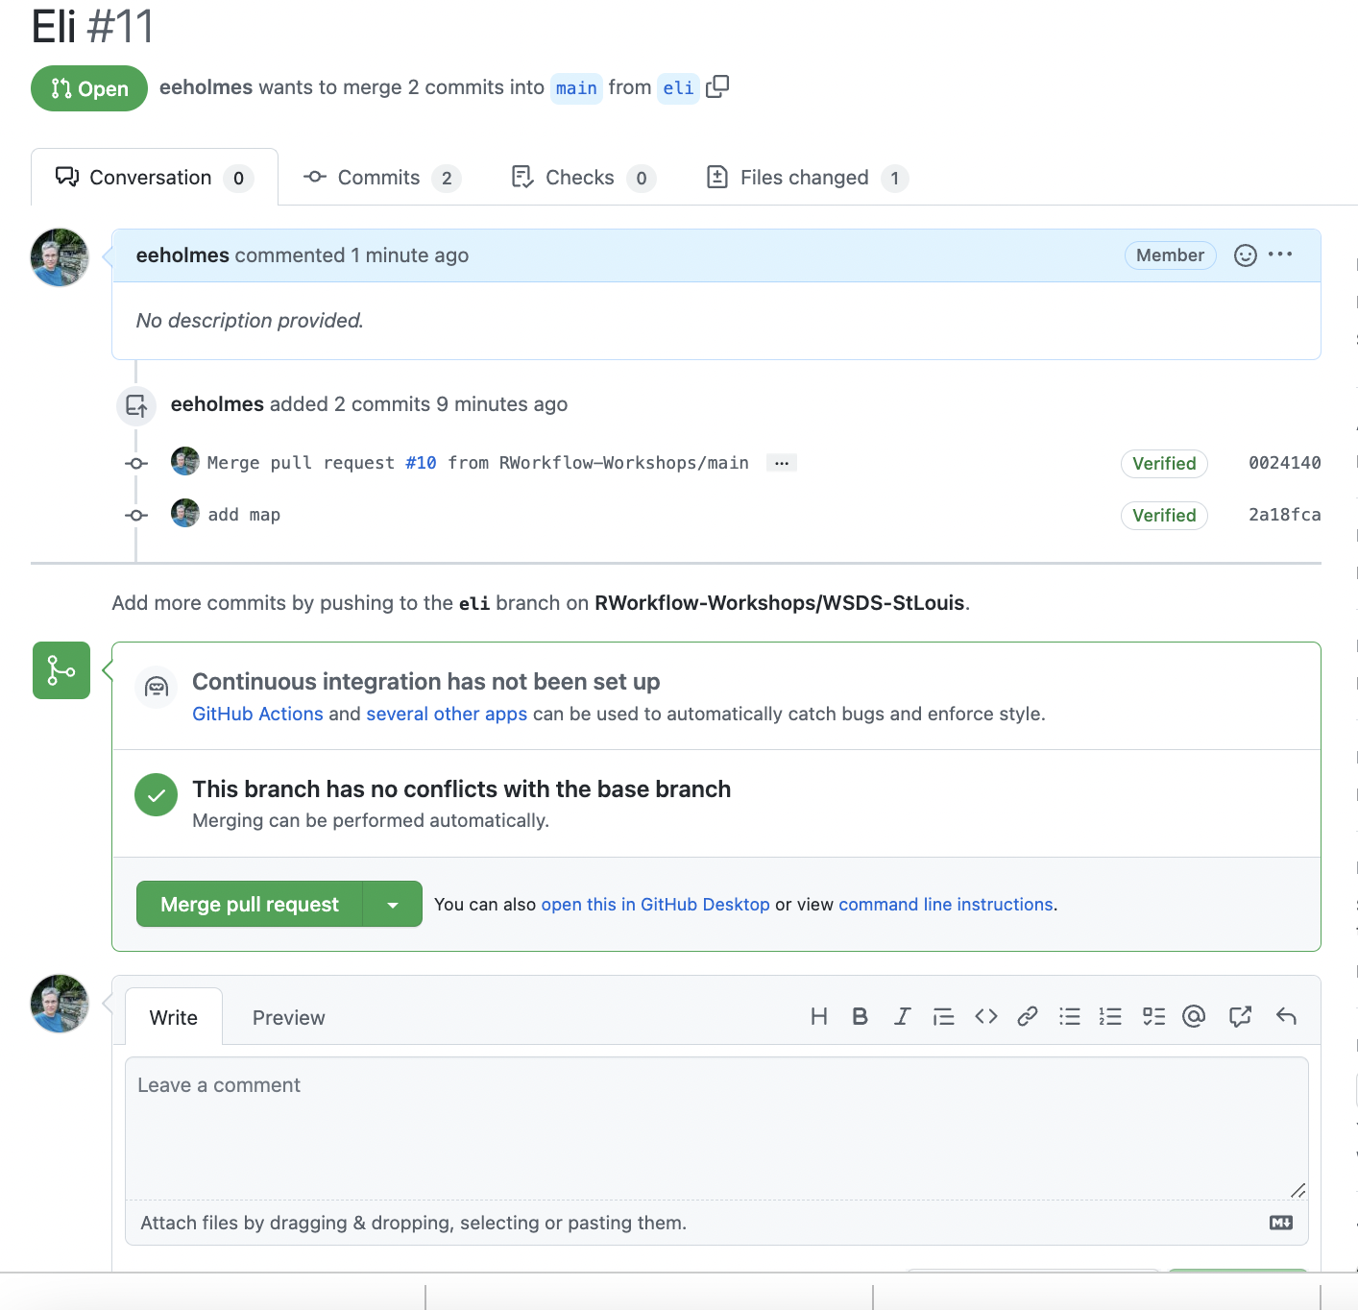
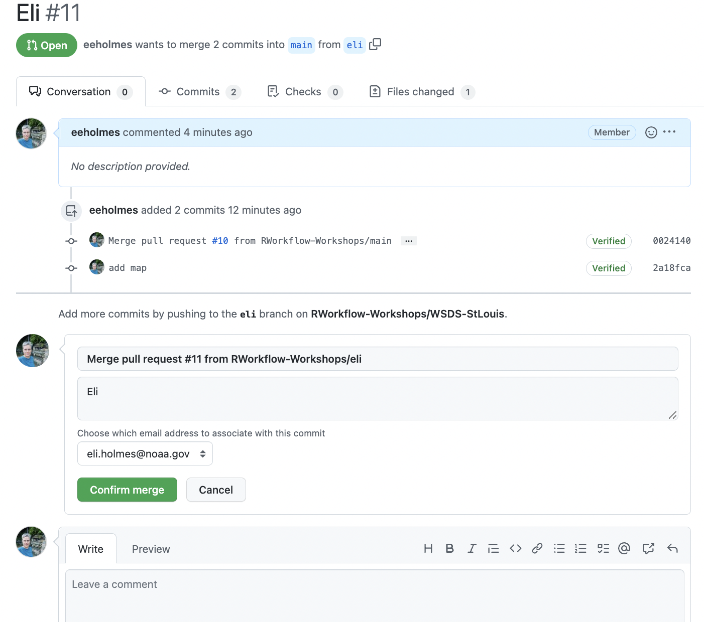
So many green buttons to click…

Slide 41
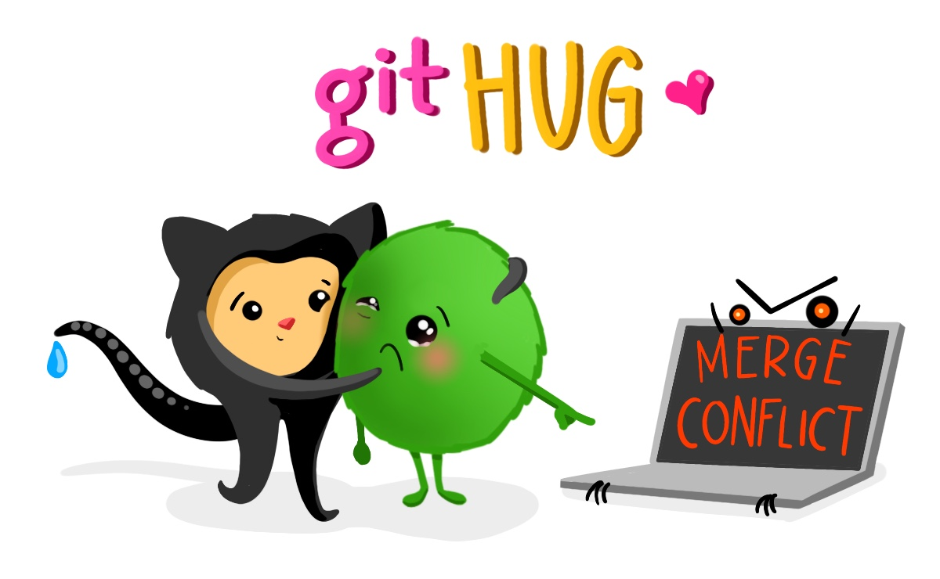
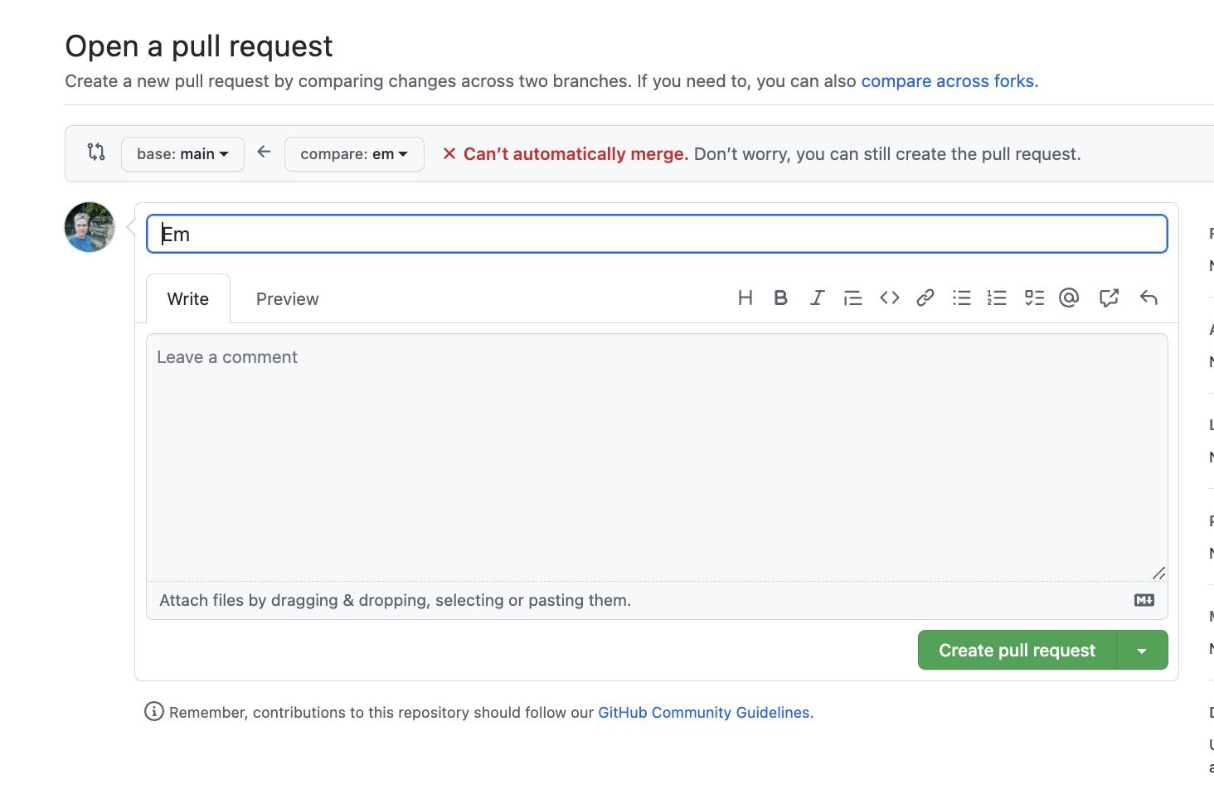
Merge conflicts
Git needs your help to resolve the conflict
Go ahead and create the pull request

Slide 42
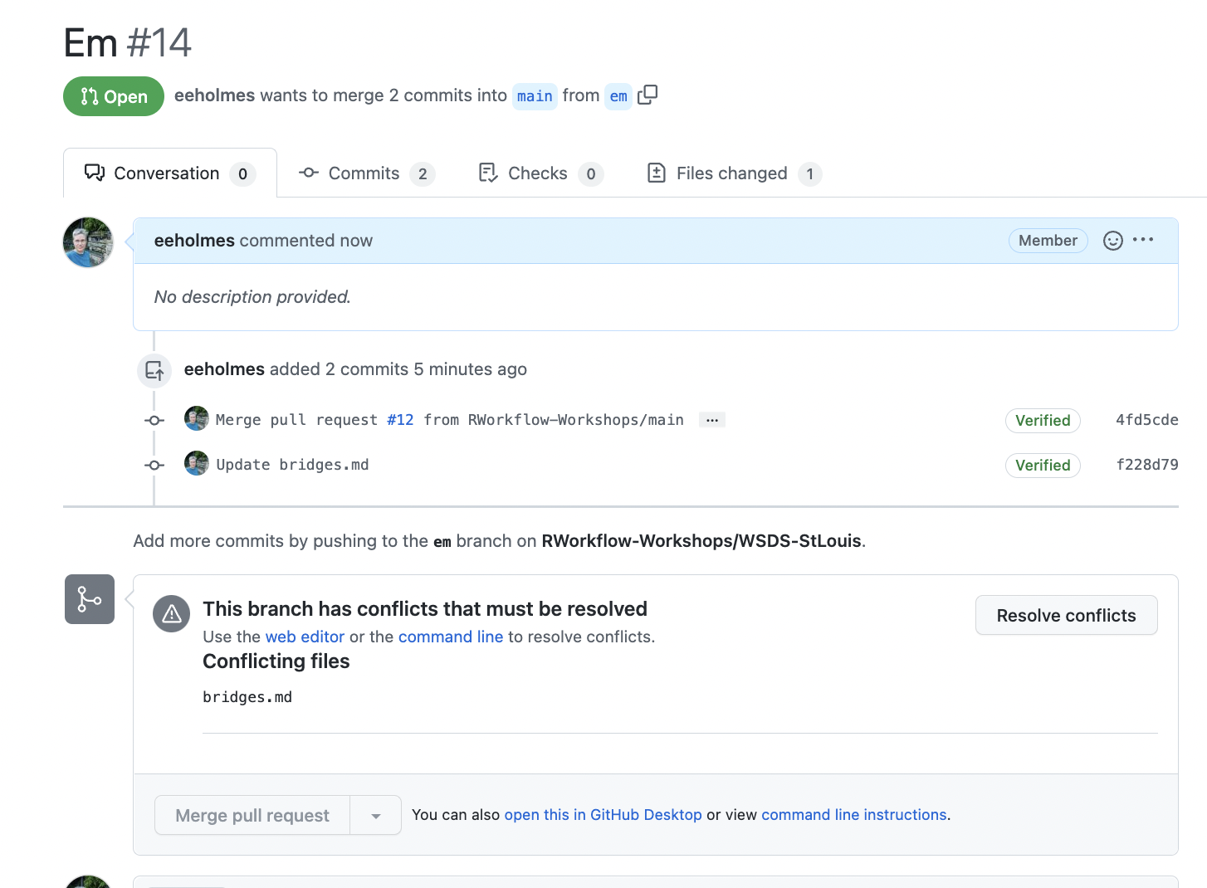
Merge conflicts
Click here to tell Git how to resolve the conflicts

Slide 43
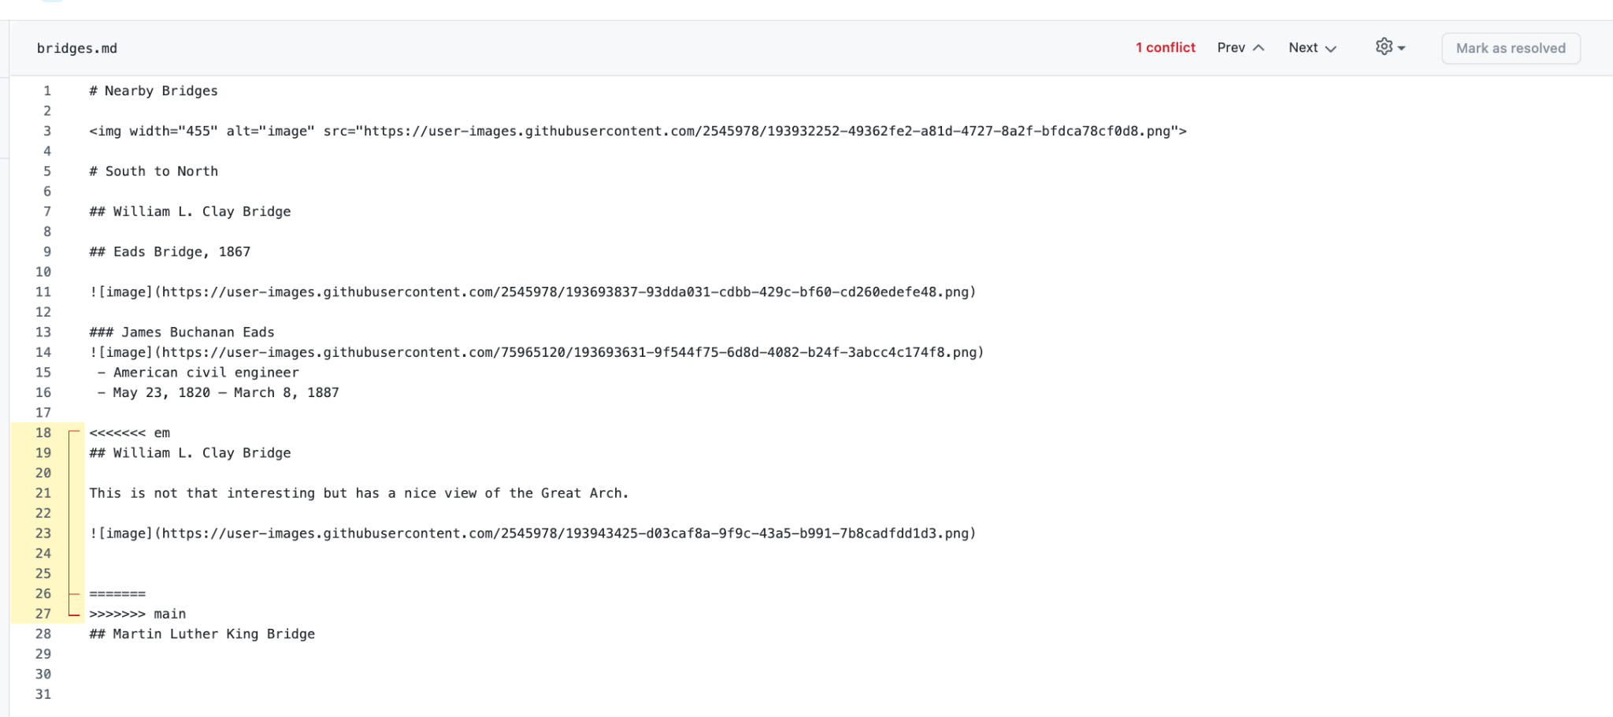
Merge conflicts
This is where the conflict is. The <<<<< and ===== just helps you find the areas that conflict. You’ll want to get rid of that.
Edit here and then click “Mark Resolved”

Slide 44
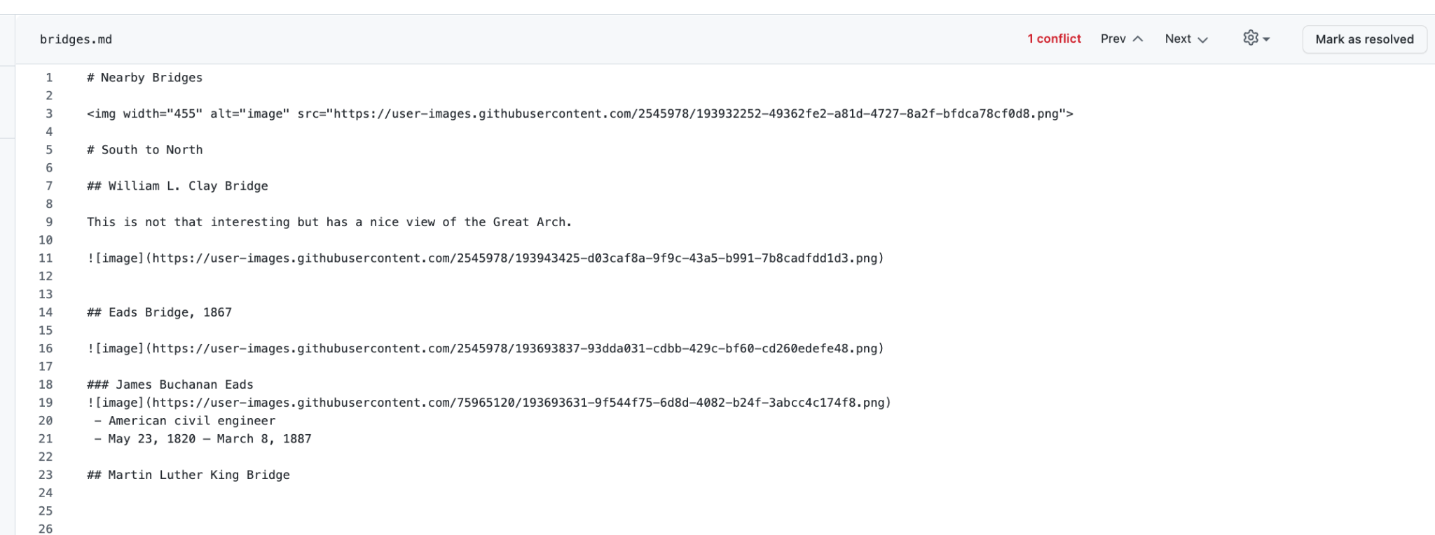
Merge conflicts

Slide 45
Eli and Em demo
Eli makes a pull request and merges
Em makes a pull request, gets merge conflict
Em resolves the merge conflict and merges

Slide 46
Team work 30 min: Pull requests
Steps
Add each pull request to the task board
One at a time, do your pull requests.
Move the task cards to done as you do each one
Work together to help each other
https://youtu.be/wmzjzuWhzq0
Artwork by @allison_horst

Slide 48
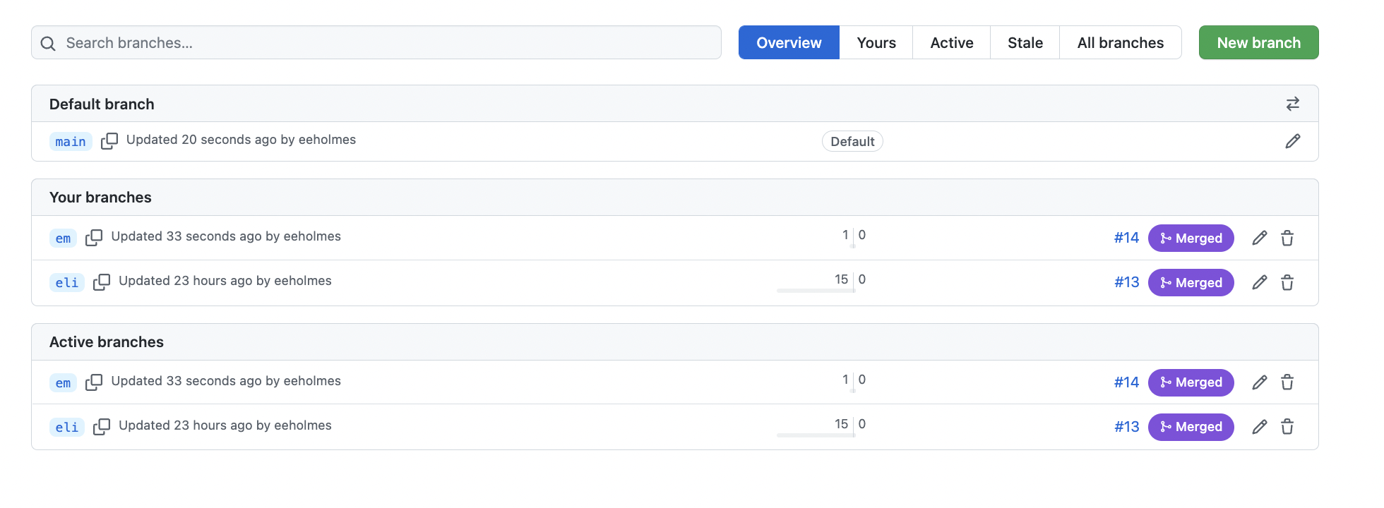
After Em merges her branch, Eli’s branch is behind main
This shows that there are commits on main that I don’t have
I need to do something about this before I start working again.

Slide 49
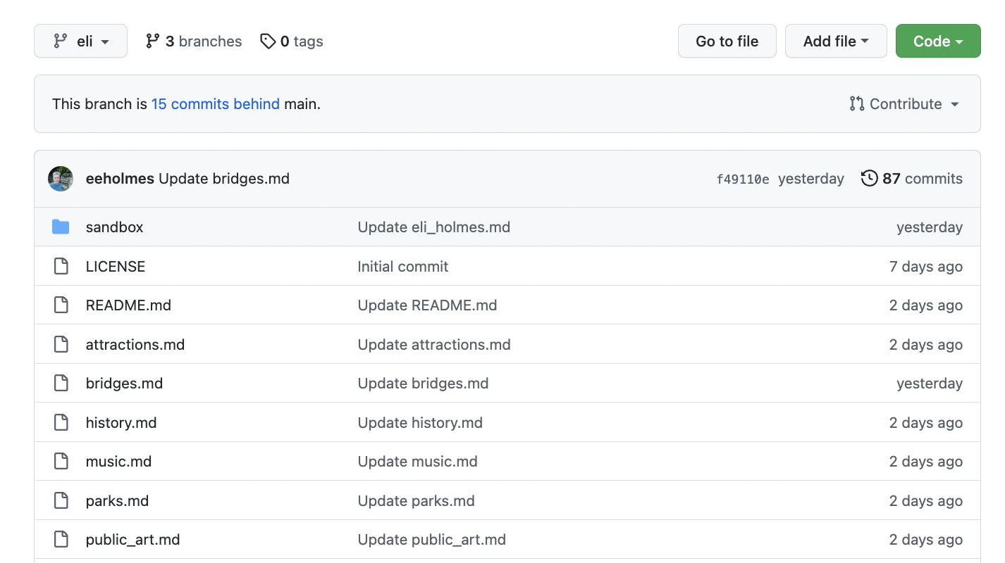
We can also see this if I am on my branch
Click here to see what is on main and start a pull request

Slide 50
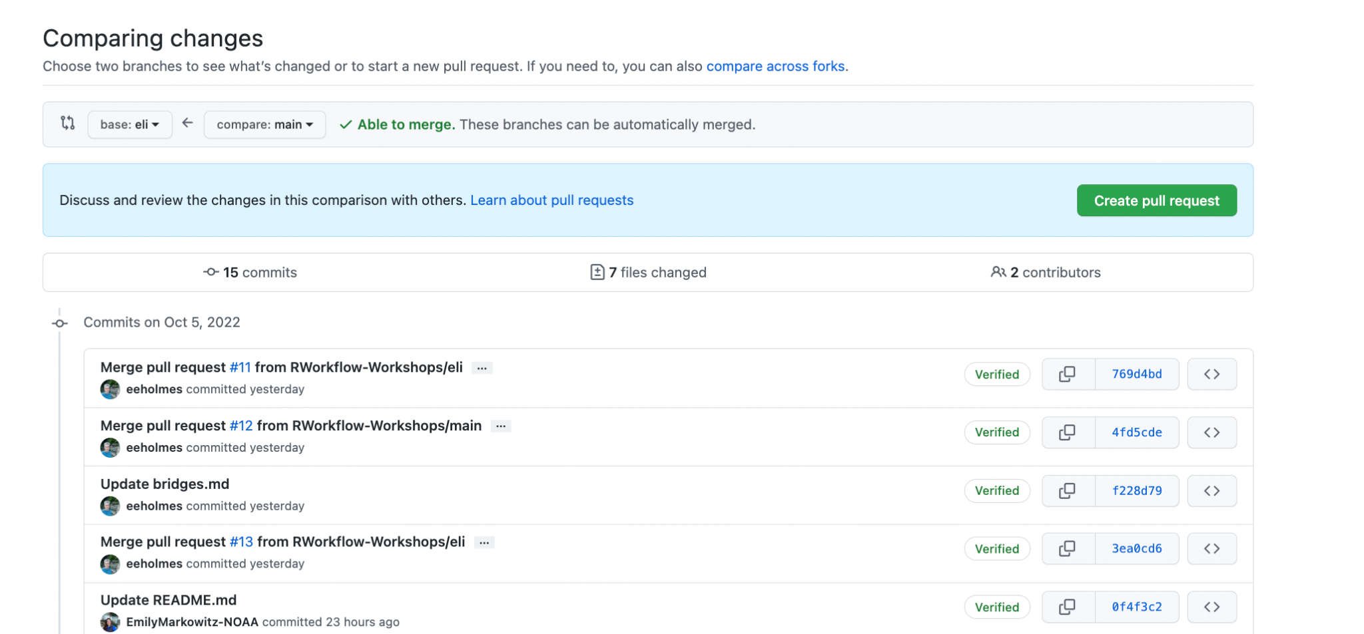
Do a pull request to merge main into your branch
Click here and merge
https://youtu.be/OkDkmMLdBD4

Slide 51
But the normal workflow is to delete your branch!
Yes!
Start task (grab a task card)
Make branch
Complete the task
Merge work into main with pull request
Delete branch
Move task card to done column
Delete my precious branch??

Slide 52
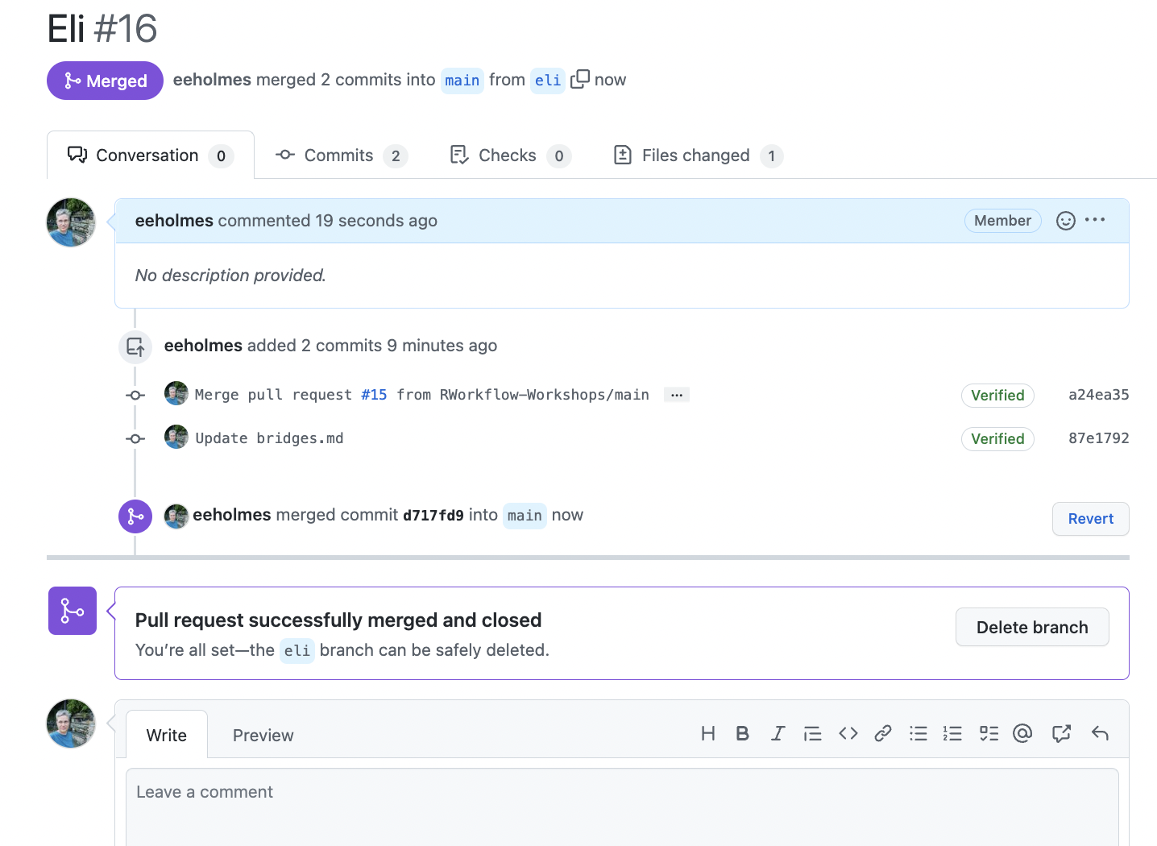
But the normal workflow is to delete your branch!
Next page

Slide 53
Or delete from “View all branches” page

Slide 54
DISCUSSION and Q&A

Slide 55
Next learning steps: GitHub Issues

Slide 56
Next learning steps: GitHub Issues
Every team uses issues.
allow a discussion
a record of any info needed to resolve that issue
documents how and when issue resolved

Slide 57
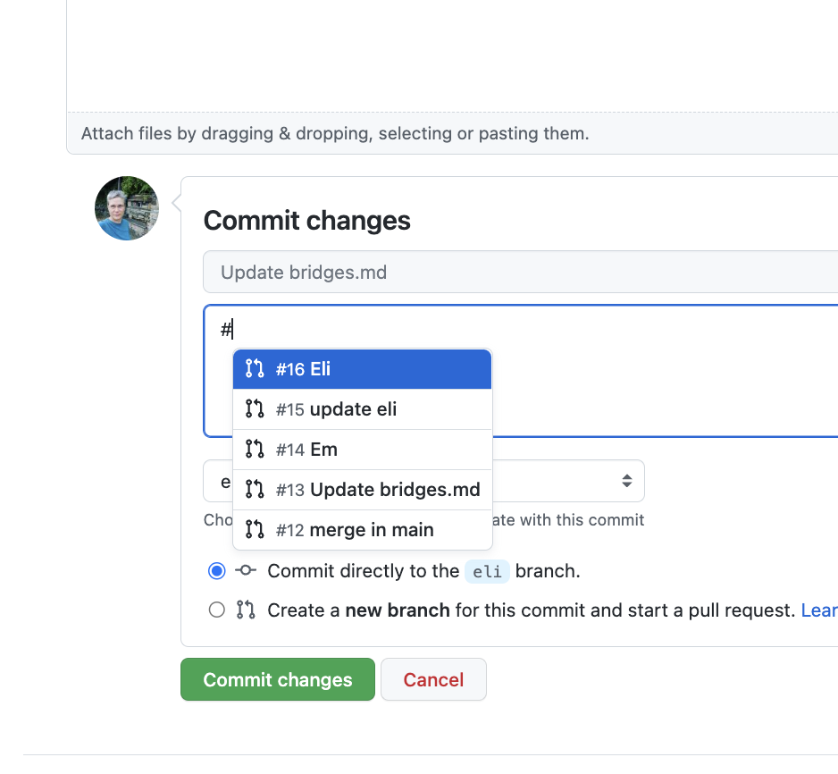
Next learning steps: GitHub Issues
When you commit a change, type # in the description area to select an issue that the commit addresses.

Slide 58
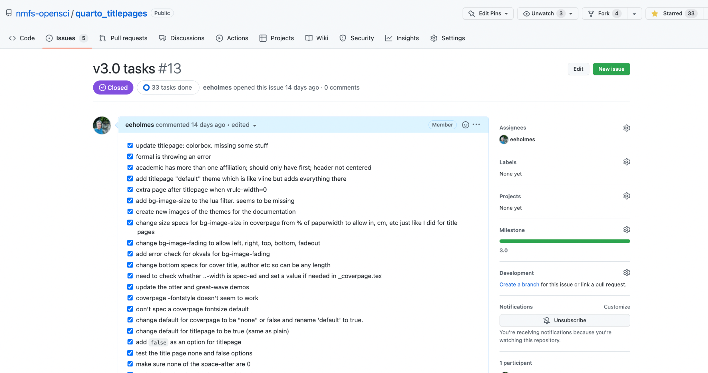
Next learning steps: GitHub Issues with check boxes

Slide 59
Next learning steps for GitHub Project Boards
Create GitHub issues
Add them to your project board
Watch them automatically move to done column on your board when you close them

Slide 60
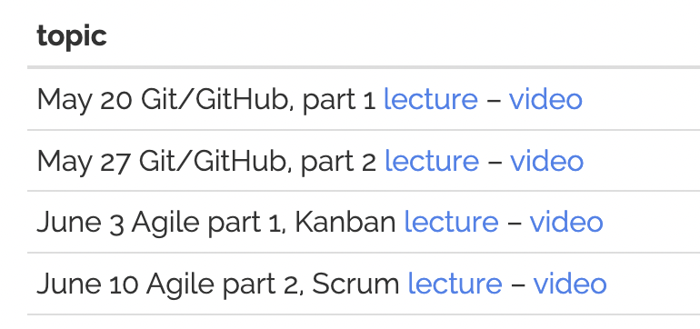
Some more material on these topics
RWorkflow 2022 Workshops (1 hr lectures)
Openscapes GitHub Clinics
Part 1 Contributing from the browser:
Part 2 GitHub Projects

